Slide 1
Pedestrian Infrastructure Planning
By Cairo Udobi, Brendan Timberlake, and Rachel Collier

Slide 2
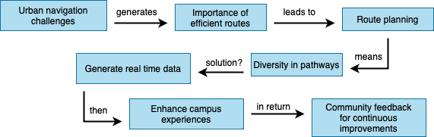
Workflow
Notes:
Urban navigation challenges - Pedestrians face challenges navigating through large and densely populated areas, especially on college campuses.
Importance of efficient routes - Efficient pedestrian routes contribute to a more pleasant experience. Optimization of routes is essential for time management, especially in academic settings with multiple buildings.
Route planning - Nearest neighbor algorithm can process large datasets and consider various factors for optimal pathfinding.
Diversity in pathways - Adding more buildings to the route. Allowing the user to choose own buildings.
Generate real time data - Provide the user with an accurate representation of campus. Includes activities about sidewalks, ongoing construction, closures, and temporary routes.
Enhance campus experiences - Optimized pedestrian routes contribute to a positive campus experience for students, faculty, and visitors.
Community feedback - The project aligns with the goal of creating user-friendly environments.

Slide 3
Motivation
Infrastructure Placement Challenge
Focus on access and inclusive design for users
Specific Issues at The University of Houston
Student complaints include poor walking infrastructure, potholes, and insufficient lighting
Analysis and Recommendations
Program analyzes results to find top three most used nodes
Suggest these nodes as high-impact corridors for public planners and designers
Benefits of Approach
Ensures development budgets are allocated efficiently
Mathematical optimization to maximize impact on student and faculty experience
Notes:
We are aiming to address how to design and improve walking paths for students, faculties and visitors around campus
A very big issue on UH is the poor walking infrastructure and how it affects our pedestrians
We will analyze the results of the top three most used nodes and then suggest the nodes as high impact corridors for planning and design
Our approach will help us make sure that budgets can be allocated efficiently and Also maximize the student and faculty body

Slide 4



Challenges
How was the accuracy of the building location and pathway ensured?
How was a user friendly interface for inputting routes designed?
What were the difficulties incorporating real time data for dynamic route adjustments?
Notes:
Obtaining accurate and up-to-date data on building locations, pathways, and pedestrian-friendly infrastructure.
Designing an intuitive and user-friendly interface for users to input their starting points and desired routes.
Ensuring that the route planning solution is scalable and can be generalized to different urban environments. (Adding more buildings for the map).

Slide 5
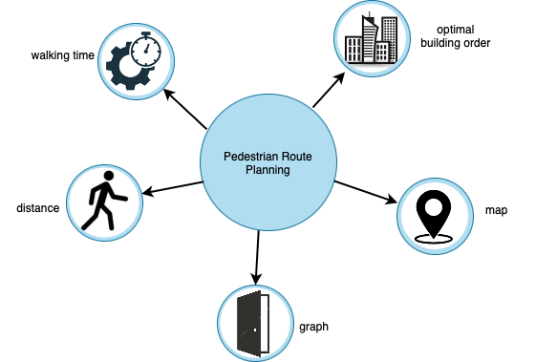
Proposed Solution
Notes:
Distance - Path length - Measure the total distance of the recommended path. The goal is to minimize the overall path length.
Walking time - Execution time - Evaluate the time taken to calculate and provide the optimal route.
Optimal building order - Shows the route with the least distance traveled to each building, making it efficient.
Graph - Show the path taken on a graph with a line connecting the points labeled. Shows all the buildings.
Map - Shows the path taken on a map. Makes the user walk on the sidewalk to the destination.

Slide 6

Achieving the Solution
Optimal building order
Displays the buildings in the route order
Walking time
Calculates the walking time for a slow and fast walker in minutes
Distance
Calculate the distance in meters, kilometers, and miles
Graph
Displays all the points on a graph with the route
Map
Displays the route on a map
Notes:
What we need for our solution is the optimal building order for people planning on visiting more than two buildings, the walking time for both slow and fast walkers, graph that displays the coordinates of the building and a live map that shows the actual walking route on sidewalks

Slide 7
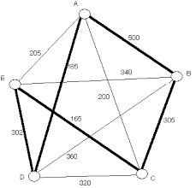




Experimental Benchmarks
Dataset
Building names
Longitude
Latitude
Algorithm
Nearest Neighbor Algorithm
Evaluation Metrics
Path Length
Scalability
Robustness
Languages
Python
Cloud Training
Google Colab
Excel
Github
Notes:
The dataset that we used were for buildings on the campus. We gathered their name, longitude, and latitude. We also used the dataset from Google API.
The algorithm used for this problem was the Nearest Neighbor Algorithm. Heuristic algorithm. Although less accurate in general, the algorithm for this project was great for finding the fastest pathing
Making sure the data present is accurate, and provided a quality solution. We also wanted to make sure it could scale and had the ability to be added on to.
Best language used for this project was python
Google Colab, Excel, and Github were great tools for making sure our project was optimal

Slide 8


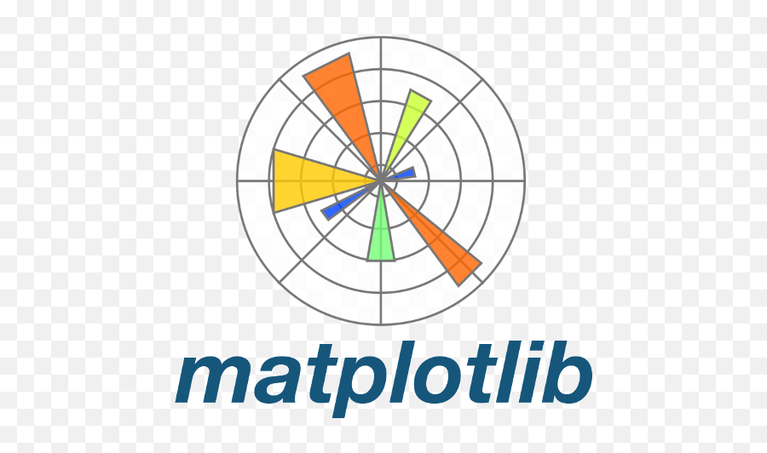
Libraries
Scipy
Google Maps API
Notes:
Scipy - for calculating distance matrix
Google maps - for visualizing the optimal walking order when visiting building
Matplotlibs - plots the coordinates of each building

Slide 9

Experimental Steps
Load the dataset of UH buildings
Make a scatter plot
Choose your own buildings
Make the optimal route, distance, and time
Draw a graph
Draw a map
Notes:
So how we will carry this out is *steps on slide*

Slide 10
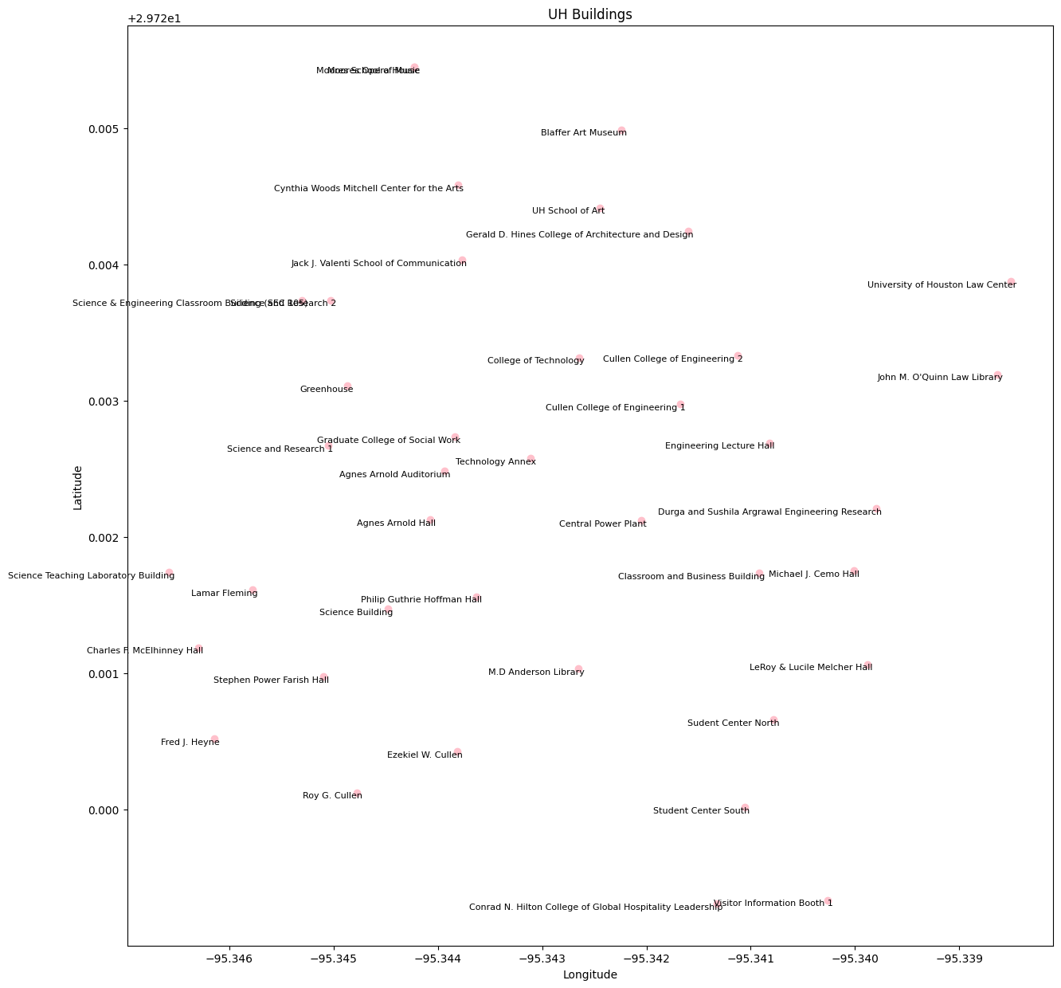
Results of all the
buildings
Scatter plot of all the buildings
Notes:
Idk just be like “here is our scatterplot” or something

Slide 11
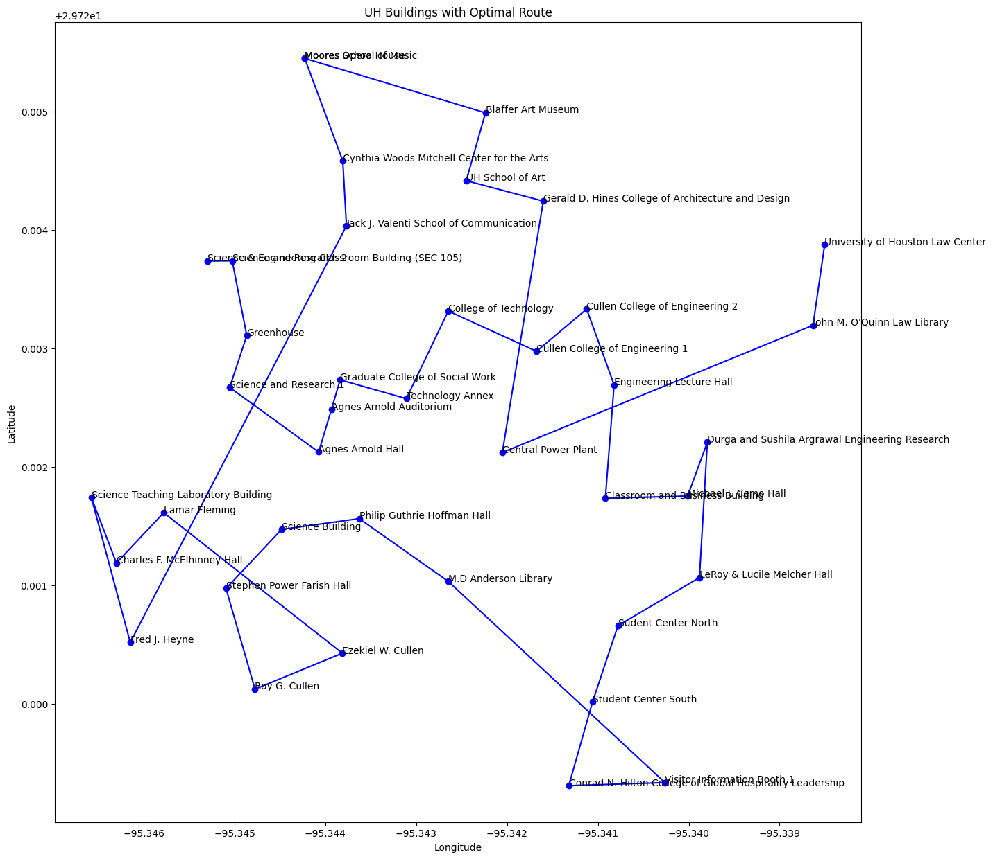

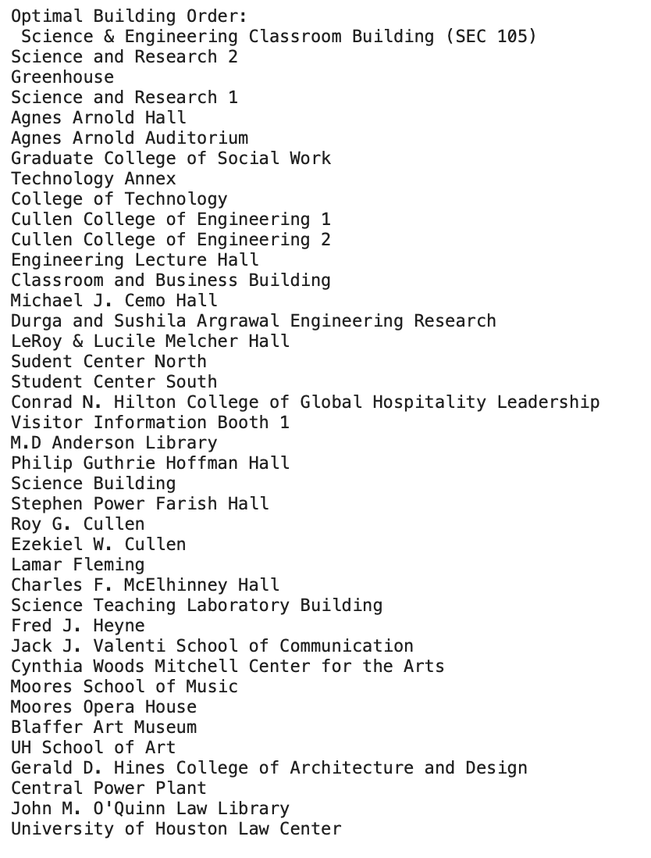
Results cont.
Notes:
Using Nearest Neighbor Algorithm, if we start at SEC, and end at the Law Center, it would take us about 50 minutes of walking about 2.7 miles.

Slide 12
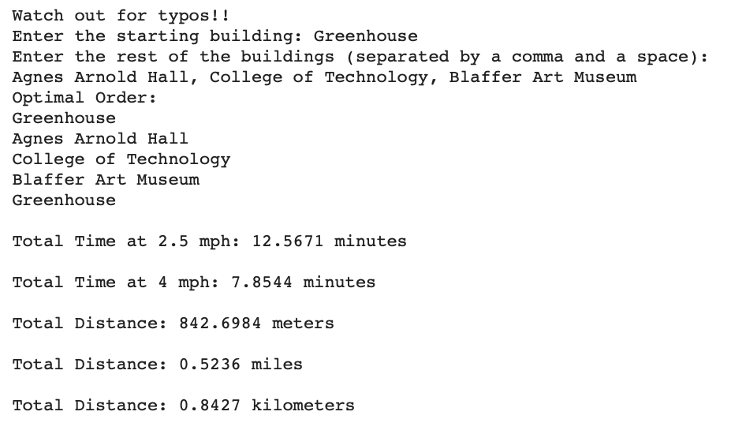
Results with Custom Path
Notes:
The user can type a custom path that allows them to enter in their own buildings to create their route to their destination. The custom path makes the user walk to the door of each building, as that is where the coordinates are placed. Watch out for typos though, as the buildings have to be exactly as written or else you will get an error.
For this example, the optimal route will be starting at the greenhouse, then anges arnold hall, college of technology, balffer art museum, then back to the greenhouse. The total time taken will depend if you are a fast walker or a slow walker. The slow walker walking will take about 13 min and a fast walker will take about 8 min. The total distance is display in meters, miles, and kilometers.

Slide 13
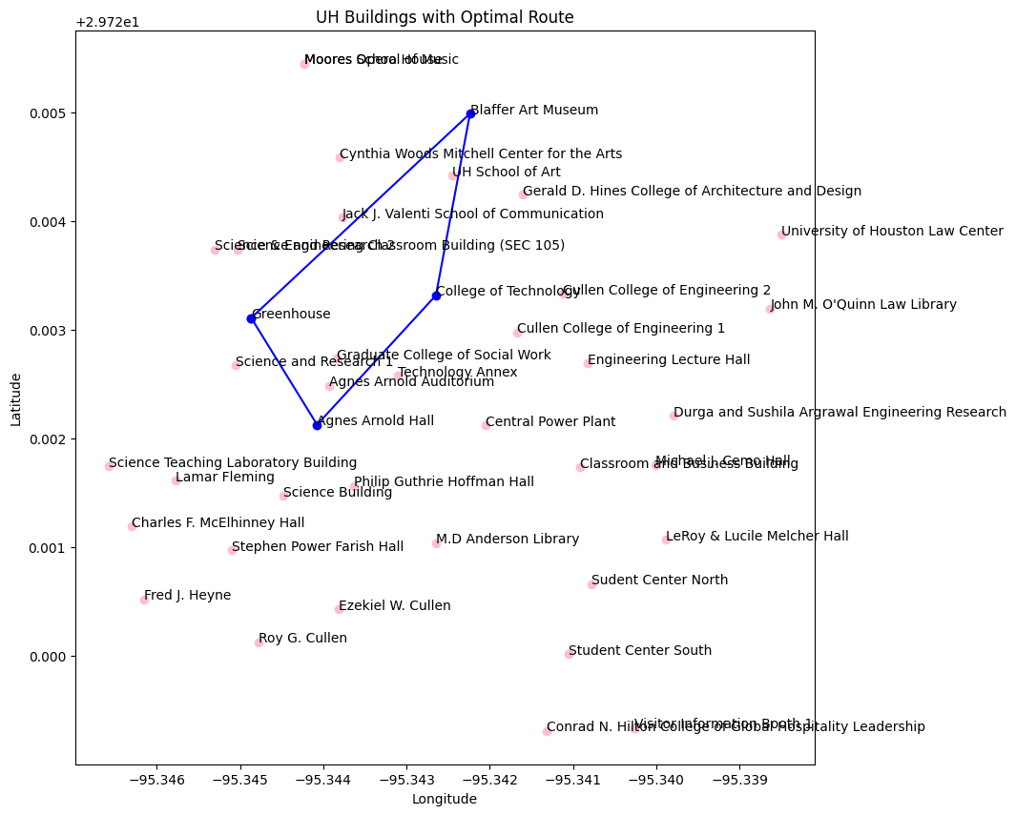
Results with Custom Path
Notes:
The path taken will be displayed on a graph. The coordinates of the buildings are the geographical coordinates (longitude and latitude) just like a map. Out of all the buildings, the buildings that the user has selected, will have the path displayed. I made the line connecting the path blue so the user can easily see where they are going. The rest of the buildings are also display on the map so the user can see to scale where they want to go. The user can see the surrounding buildings on the path that they are going to take.

Slide 14
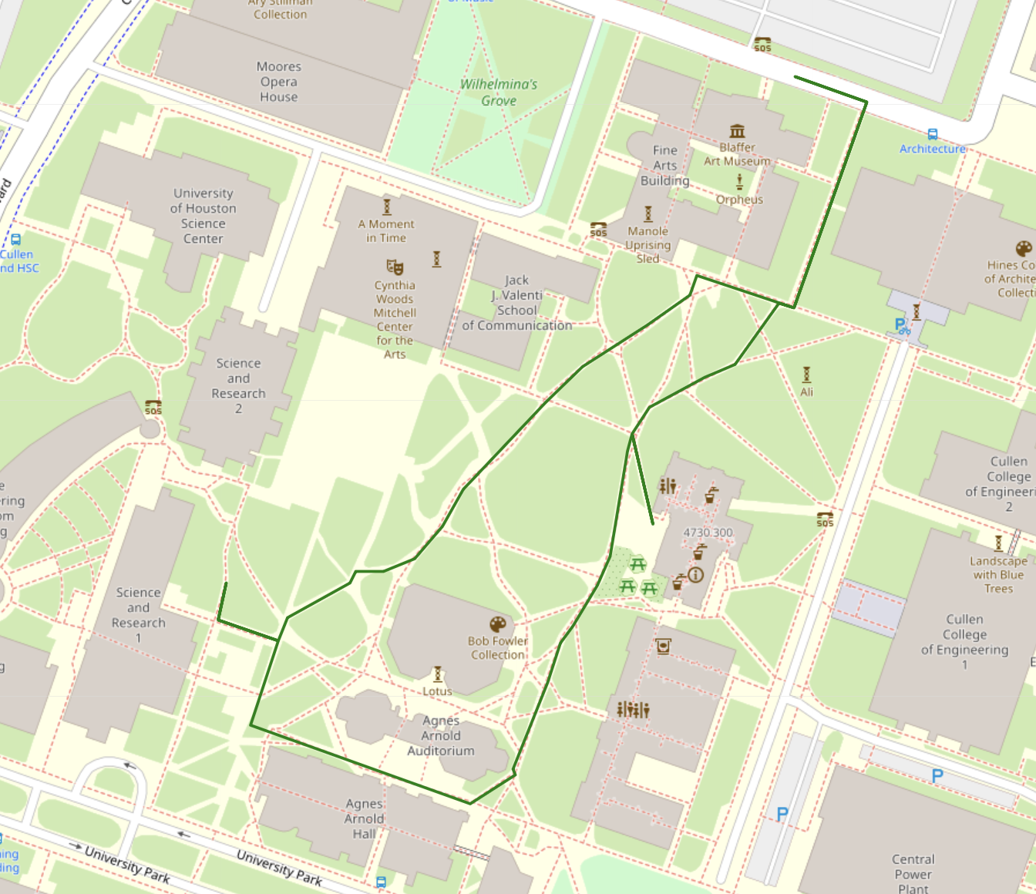
Results with Custom Path
Notes:
The route will now be displayed on a map. The path runs from beginning to end, indicating the optimal route the user will take to reach their destination. The path is more accurate on the route and shows the user walking on the sidewalk precisely.

Slide 15

Limitations
User interface complexity
Despite efforts to design a user-friendly interface, the complexity of urban navigation could pose challenges for users unfamiliar with the system
Scalability
The generalization of the route planning is sized to only buildings on campus, limiting its applicability beyond the specific use case
Changes
The absence of updates, such as live traffic, construction, or weather, could limit the system's responsiveness to dynamic changes.
Notes:
User interface complexity - The design of how people enter in the buildings to create their route. The user has to enter the full name of the building to put it in the route. The user can not enter an abbreviation of the building. There is limited user guidance. The user doesn’t have a list of all the possible places to go. The user can make an educated guess type what buildings that are in this dataset. There is only 40 buildings, witch is most but not all of the buildings.
Scalability - The data set is almost at maximum places of where the user can go; most of UH buildings are listed in this program. If we decided to add more places, it wouldn’t be buildings, it could be statues or landmarks on campus, or other important places. We can also mark down a tree if necessary.
Changes - UH is still a growing campus, and pathways can be blocked off for construction. For example there is construction by the science and research building 2, making a new building being built. Also, there is a different amount of people on campus depending on the time of day. There would be more people on campus mid day than rather in the morning. Also the weather could affect the amount of people on campus.

Slide 16
Improvements
With having a small dataset and being familiar with the buildings at UH, we could add a recommended places to go.
Notes:
Rachel’s favorite buildings, Brendan’s favorite buildings, Cairo’s favorite building. The dataset only has numerical values (coordinates), we could add some words. I also think that this makes our project more meaningful and having a personal touch of us.

Slide 17
Take Away
Our objective is to empower individuals to navigate the campus efficiently and confidently, enhancing their overall experience and ensuring they have the most reliable guidance to get to their destinations the fastest way possible.
Notes:
As stated before, our goal is to make walking on campus easier for students, faculty and visitors and for them to receive guidance on how to get to where they want on time and efficiently

